Slide 1
Creating Awesome Chat Bots with the Bot Framework and C#
Presented by Andy Schwam

Slide 2

Andy Schwam
Developer | Architect | Manager: Global Indemnity in Bala Cynwyd
@schwammy
www.schwammysays.net
andy@ingenuitynow.net
Focus: Web, Mobile, Bots and AI

Slide 3
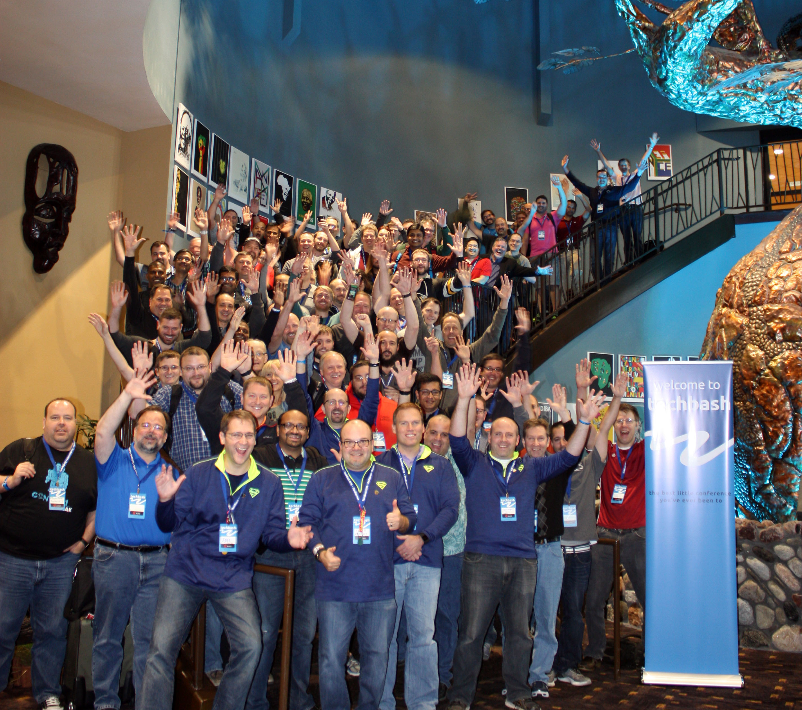

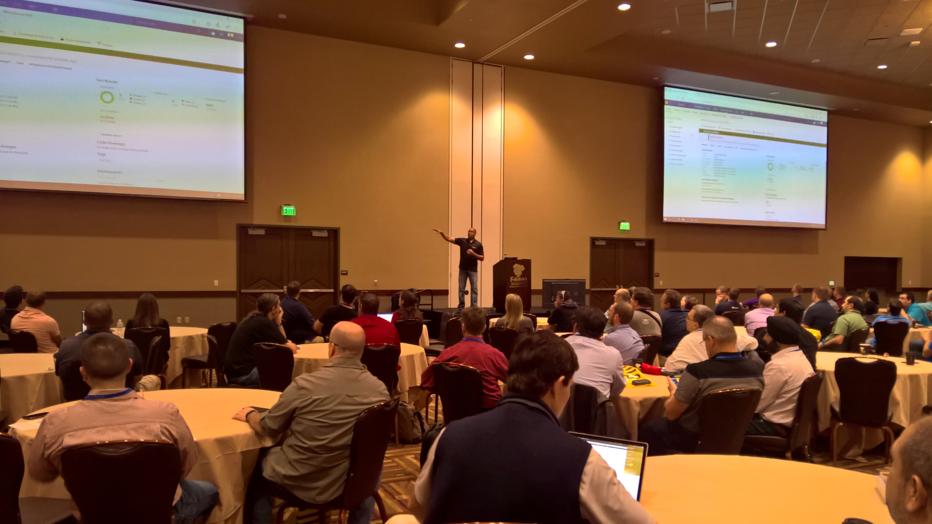

TechBash 2018
October 2-5th, 2018
Kalahari Resort – Pocono Manor, PA
North America’s largest indoor water park!
Central Location
TechBash is local to New York City, New Jersey and Philadelphia and within driving distance of Boston, Pittsburgh and Washington, DC.
70+ Sessions and Full-Day Workshops
TechBash will have over 70 sessions covering the freshest and most relevant topics. Full-day in-depth workshops on Tuesday are new for 2018!
World Class Event
TechBash focuses on being a world class event where you'll walk away feeling inspired to build amazing things.
Sign up for info or submit a session at www.techbash.com

Slide 4
Azure Bot Service - Demo
Bot Service in Azure hosts your bot
Connect to various channels
Cortana
Teams
Skype
Etc.
Test
Edit

Slide 5
Demo
A demo of the TechBash bot
Sessions
Evaluations
Registration
Other Info

Slide 6
Demo: Visual Studio | new Bot
Startup.cs
ConfigureServices:
services.AddBot<EchoBot>
Middleware for exceptions and state management
Configure: UseBotFramework (similar to UseMVC)
EchoBot.cs
OnTurn
We could examine the text coming in for each request and figure out the response manually.

Slide 7
Tips for Bot Building
Don’t pretend to be real – honesty and transparency builds trust.
Monitor and re-train your bot.
Be prepared for silly questions
Have fun!
Creating a conversational bot is much harder than it seems.

Slide 8
LUIS
www.luis.ai
Language Understanding Intelligent Service
Need a separate account
LUIS can be trained to understand:
Intents
Entities
Phrase Lists

Slide 9
LUIS Demo
Build, Train and Publish on www.luis.ai
Luis Recognizer Middleware

Slide 10
Design
Question is asked
LUIS determines the intent
LUIS middleware gets the intent and the entities
Schedule
Feedback/Eval
Other
Passes request to the QnA Maker

Slide 11
Manage conversation flow with dialogs
Use waterfall to create a multi-step dialog to prompt user for input.
Uses inputs: text and buttons
Use Prompts to get input from users:
TextPrompt
ChoicePrompt
NumberPrompt
DateTimePrompt
ConfirmPrompt
AttachmentPrompt

Slide 12
Demo Dialogs and Prompts
ScheduleDialog
Single Step
SessionEvaluationDialog
Multiple steps. Bot asks user multiple questions to get the information the bot needs to perform the action.

Slide 13
QNA Maker
Easy to get started – import FAQ
“None” Intent

Slide 14
Bot Builder v4
Currently in Preview
https://github.com/Microsoft/BotBuilder
https://docs.microsoft.com/en-us/azure/bot-service/?view=azure-bot-service-4.0
Supports .NET, JavaScript, Python, Java

Slide 15
Tools
Azure Bot Service – to host our bot
Bot Builder SDK v4 (preview)
C# (v4 supports .NET, JavaScript, Python, Java)
LUIS (part of the Cognitive Services set of tools)
LUIS Gen https://github.com/microsoft/botbuilder-tools
QnA Maker
Bot Builder SDK v4 template for C#
BotFramework Emulator

Slide 16
Adaptive Cards
Adaptive Cards
http://adaptivecards.io/

Slide 17
Deploy
There are many ways to deploy a bot to Azure. It’s just a web app ☺
Set appid and password in config
Remove existing files from bot in azure

Slide 18
WebChat Control
Show BotHost.html
https://github.com/Microsoft/BotFramework-WebChat

Slide 19
Debugging
Use Bot Framework Emulator – local
Use Bot Framework Emulator – Azure (use ngrok)
Remote debugging to Azure
get publish profile from Azure (for credentials)
Publish to Azure from Visual Studio (so you can do a debug build)
Attach to process via [azure app service ]:4022

Slide 20
Questions?
@schwammy
andy@ingenuitynow.net
www.schwammysays.net

